Slide 1

Increasing Revenue and Decreasing Costs
by Eimear Bonner

Slide 2
Executive Summary
Challenge
Identified low conversion rate and high cart abandonment rate.
Limitations
Average competitor statistics is secondary data and I cannot guarantee it’s accuracy.
When identifying non-registered customers, a customer may have a regular cookie churn and this could lead to inaccurate tracking of returning visitors.
Assumptions
The data doesn’t explicitly account for external market factors such as COVID-19. We assume that these factors have stabilised for future recommendations.
We assume that the return rates for brands will remain constant unless targeted changes are made.
Solution
I will identify strategies to improve conversion rate and cart abandonment.
Recommendation
Enhance Prism’s revenue and reduce cost through conversion, our most profitable areas and our highest returns.
Notes:
This is the executive summary of the presentation which outlines the challenges, solutions and recommendations I have identified.
I have also acknowledged the limitations of and assumptions from the dataset.

Slide 3
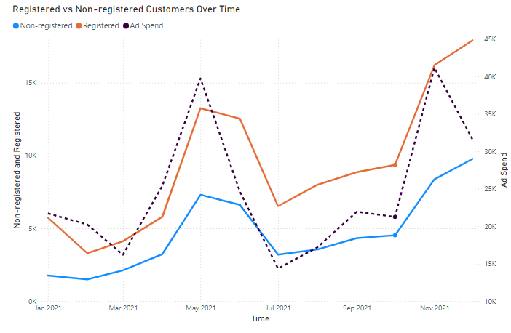
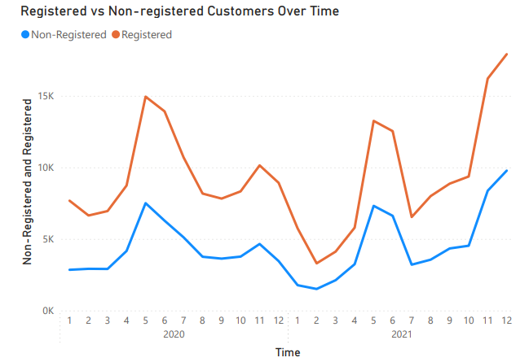
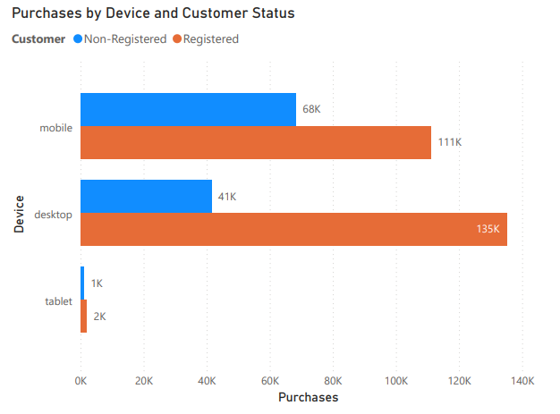
Registered vs Non-registered Customers
0.8%
Notes:
Registered vs Non-registered customers over time
Rise in purchases from both registered and non-registered customers.
The increase in ad spend correlates with the rise in registered purchases, which could drop if ad spend is reduced.
Simplify registration before high ad spend times, such as logging in via facebook, and use personalised recommendations for registered customers could be an incentive that sees more customers register with us, increasing retention.
Purchases by Device
Tablet usage is minimal compared to desktop and mobile.
Investigate UX issues for tablets.
However, It may be more effective to deprioritise tablet optimisation (only 6% of UK market share in comparison to 12% 5 years ago)
Mobile UX – incorporate apple and google pay.

Slide 4
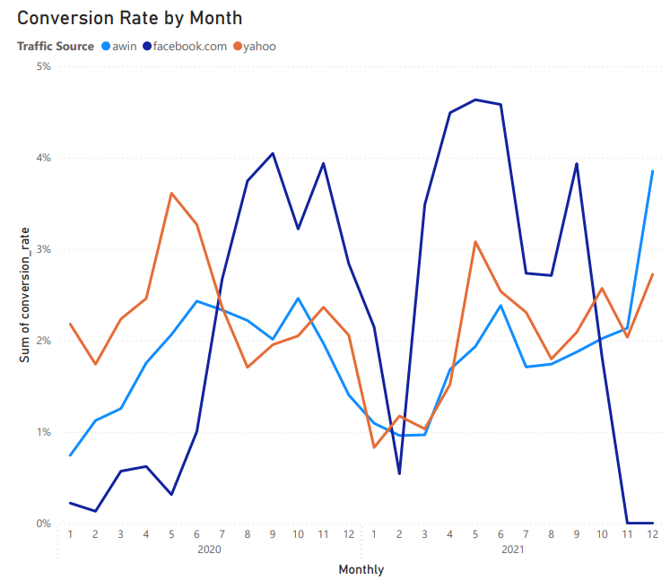
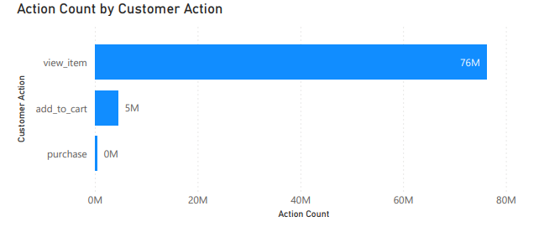
Conversion Rates and Engagement
Last 30 days increase
Item views 121%
Add to cart 170%
Purchase 141%
Competitor’s average
2.5 – 3%
Prism’s average
1%
Notes:
Item Engagement:
An increase in engagement, but still a high drop-off to add to cart and purchase (90.07% cart abandonment).
Implement abandoned cart reminders and improve search/filter functions to help users find items more easily.
Lack of Product Information such as poor item descriptions or low-quality images may also be contributing to our high drop off between engagement actions.
Conversion Rates:
Prism’s average conversion rate (1%) is below our competitors’ (2.5%-3%).
Use A/B testing for landing pages and introduce urgency elements (e.g., limited-time offers) to boost conversions.

Slide 5
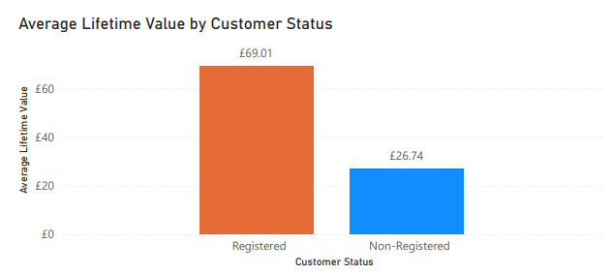
Average Lifetime Value
Registered vs Non-registered customers
Registered Customer ALV
158.09%
Notes:
I want to highlight that converting our customers into registered users should be a priority for us as the customer lifetime value is more than double that of a non-registered customer.

Slide 6
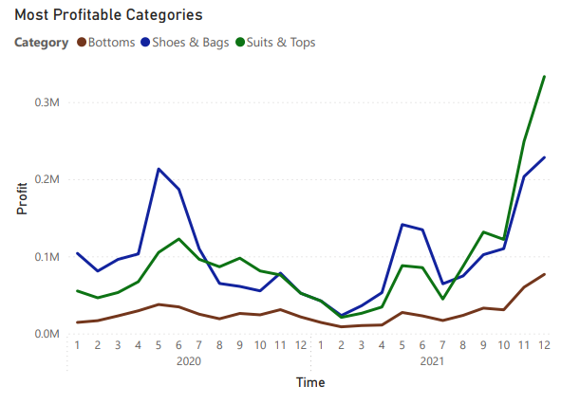
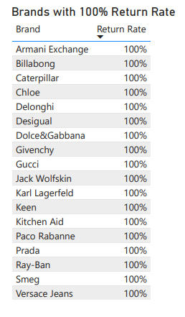
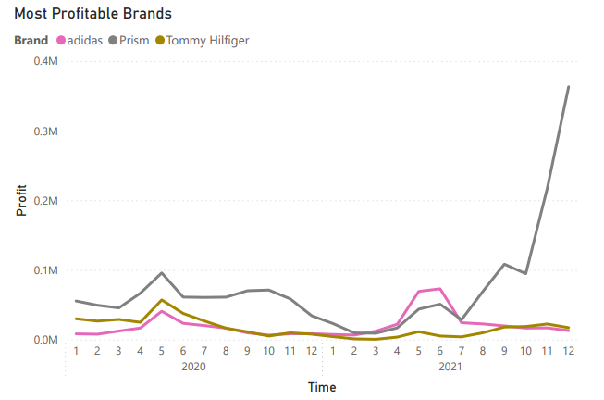
Most Profitable Brands and Categories, Alongside Return Rates
Increase inventory in top performing categories
Reduce inventory across these 18 brands
Increase own-brand inventory
Notes:
Top Product Categories
I recommend that we increase inventory for high-performing categories.
Top Brands
I recommend that we boost marketing and inventory for Prism and Adidas.
100% Return Rate
18 brands show 100% return rate, indicating product issues or unmet expectations.
I recommend that we reduce stock for now and gather customer feedback via return surveys.

Slide 7
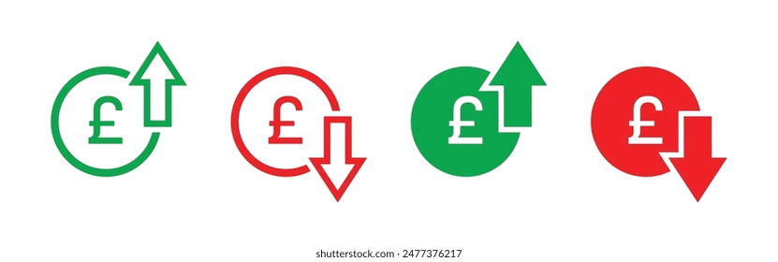
Conclusion
Reduce inventory for brands with 100% return rate
Deprioritize Tablet Optimization
Simplify registration process
Simplify mobile checkout process
Investigate UX issues
Increase inventory for Prism and Adidas brands
Increase inventory in top categories
Abandoned cart reminders
Notes:
Here is an overview of opportunities to increase Prism’s revenue and decrease costs.

